Slide 1

Traffic management PHASE -3 DEVELOPMENT PART 1
SUBMITTED BY : M.EVANGELIN
R.KAVIYA
B.SNEHA
G.SUBULAKSHMI

Slide 2
CONTENT
Introduction
Drawbacks of traffic management
Hardware component
Software component
Steps to create the traffic management
Coding
Design
Development
acknowledgement

Slide 3
INTRODUCTION
To manage traffic flows and the effects of congestion on the roading network
The traffic management effects of accidents and slow moving or queuing vehicles
Traffic comprises pedestrians, vehicles, or herded animals, trains, and others conveyances that use public ways(roads) for travel and transportation.

Slide 4
DRAW BACK OF TRAFFIC MANAGEMENT
May not be effective in reducing speed of traffic if no deflection is possible.
Turning movements may serve to encourage more traffic onto side roads.
If no islands are available, pedestrains find it difficult to cross the junction.

Slide 5
HARDWARE COMPONENT
Connect CCTV cameras.
Connected traffic light systems.
Small toll gates / electronics road pricing gantry systems.

Slide 6

HARDWARE COMPONENTS

Slide 7
SOFTWARE COMPONENT
Big data and predictive analytics.
AI/ML : Computers vision optical character recognition (OCR) reinforcement learning.
Location-based services.

Slide 8
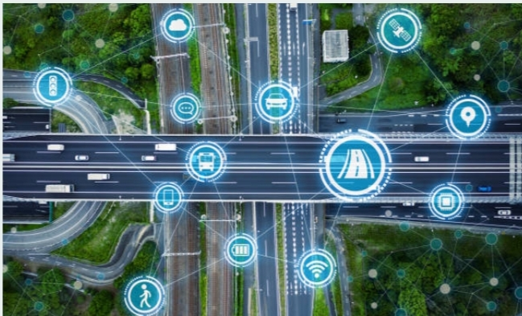
SOFTWARE COMPONENT

Slide 9
STEPS TO CREATE THE TRAFFIC MANAGEMENT
Change traffic routes to reduce or eliminate contact points.
Ensure traffic routes are well lit when in use.
Establish pedestrain no-go zones.
Control pedestrains traffic by installing barriers, railings and/or designated walkways.
Install visual and hearing aids.

Slide 10
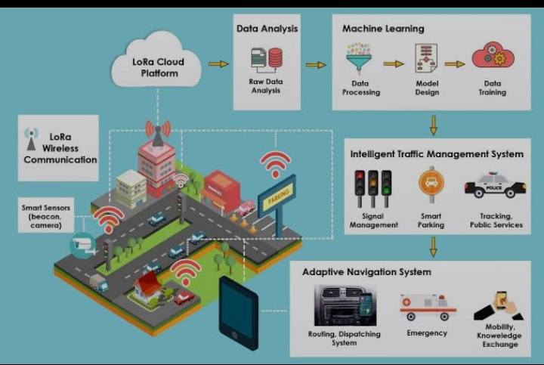
CREATE THE TRAFFIC MANAGEMENT

Slide 11
CODING
#include <iostream>
#include <vector>
#include <string>
#include <ctime>
# include <chrono>
#include <thread>
using namespace std;
// Define a class for a Traffic Light
class TrafficLight {

Slide 12
private:
string color;
public:
TrafficLight() {
color = “red” ; // set the initial color to red
}
string getColor() {
return color;
}
void setColor(string newColor) {
color = newColor;
}
};
//Define a class for a Traffic Signal
Class TrafficSignal {

Slide 13
Private:
TrafficLight light;
string name;
int duration;
public:
TrafficSignal(string n, int d) {
name = n;
duration = d;
}
string getName() {
return name;
}

Slide 14
void setStatus(string newStatus) {
light.setColor(newStatus);
}
Int getDuration() {
return duration;
}
};
//Define a class for a Traffic Junction
Class Trafficjunction {
private:
vector<TrafficSignal>signals;

Slide 15
Public:
void addSignal(trafficSignal signal) {
signals.push_(signal);
}
TrafficSignal getsignal(int index) {
return signal[index];
}
Int getSignalCount() {
return signals.size();
}

Slide 16
void run() {
int index = 0 ;
while (true) {
TrafficSignal signal = getSignal(index);
string signalName = signal.getName();
int signalDuration = signal.getDuration() ;
// Set the current signal to green
Signal.setStatus(“green”);
Cout<<signalName<<“is”<<signal.getStatus()<<
endl;

Slide 17
//Wait for the signal duration
this_thread::sleep_for(chrono::seconds(signalDuration));
// Set the current signal to red
signal.setstatus(“red”);
cout<<signalName<<“is”<<signal.getStatus()<<
endl;
}
}
};

Slide 18
//Define a main function to test the Traffic Management System
int main() {
//Create a Traffic Junction
TrafficJunction junction;
//Create and add Traffic Signals to the junction
TrafficSignal signal1(“signal 1”, 5);
Junction.addsignal(signal1);

Slide 19
TrafficSignal signal2(“signal 2” , 5);
junction.addSignal(signal2);
// Start the Traffic Junction
junction.run();
return 0;
}

Slide 20
DESIGN
Identity the problem: The first step is to identify the problem that the traffic control system is intended to solve.
Conduct a traffic study: A traffic study is an analysis of the traffic patterns and volume at a particular location.

Slide 21
DEVELOPMENT FOR TRAFFIC MANAGEMENT
Traffic management factors include government - initiated development plans that take into account the characteristics of a city and the needs of city development, including urbanization, city spatial structure, traffic planning, and operational management, among others.

Slide 22
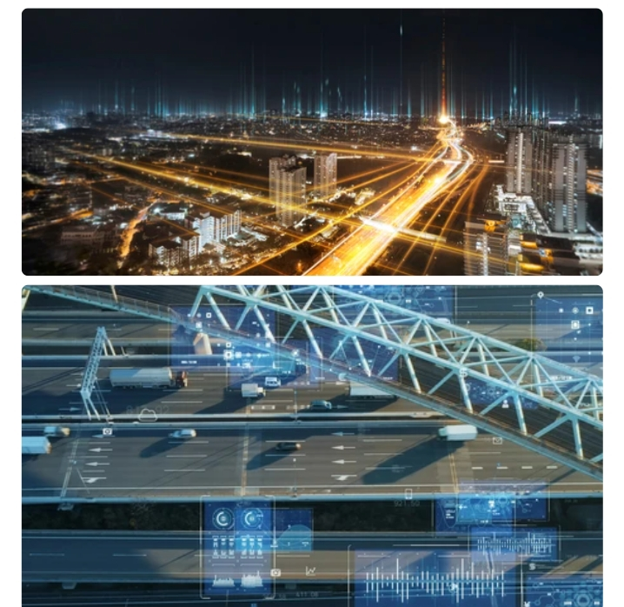
DEVELOPMENT

Slide 23
THANK YOU
Our acknowledgement to our mentors, naan mudhalvan team, IBM team, and also our management.

